Slide 1

2nd year Maths projects : Research and critical thinking
Ann Brew
Library
May 2020

Slide 2
Introduction
Resources and researching
Referencing and plagiarism
Critical thinking

Slide 3
Question
You’ll be asked questions throughout this slideshow, via menti.com
Please stop watching the slideshow at this point, answer the question, and then return to the slideshow.
Go to menti.com and use the code 54 73 08

Slide 4
Resources
First stop : Mathematics subject page
General databases (Scopus, Web of Science)
Specific databases (MathSciNet)
Online resources (Wolfram Mathworld)
E-book and e-journal collections
Reference management help
Contact details
Library Search

Slide 5
Searching for articles
Google Scholar
Web of Science
Scopus
MathSciNet
ArXiv
Wolfram Mathworld
Notes:
Four very different types of search tools:
Google Scholar : easy to use, but gives WAY too many results – see example
Web of Science : easy-ish to use, more flexibility with your search
Scopus – very similar to Web of Science, so don’t use both.
MathSciNet – dedicated to maths. Not such a pretty interface, but much richer results
ArXiv – not a database as such, but a repository of articles. Cutting edge research, but still in a raw form, potentially. Not the easiest search form
Wolfram Mathworld – good for ‘Wikipedia’ type deifnitions.
There, a few places to look for information.

Slide 6
Question
You’ll be asked questions throughout this slideshow, via menti.com
Please stop watching the slideshow at this point, answer the question, and then return to the slideshow.
Go to menti.com and use the code 54 73 08

Slide 7

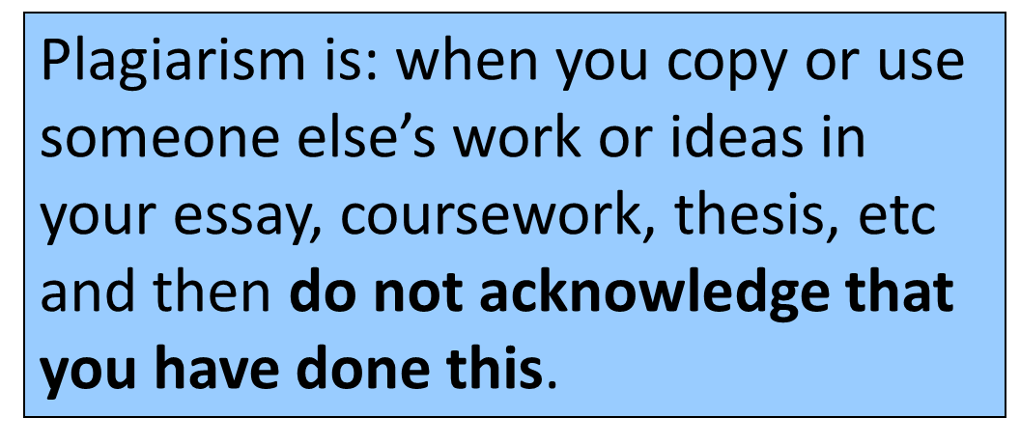
Plagiarism
Notes:
Note – this statement makes no distinction between deliberate and accidental plagiarism and neither will markers, so referencing is really important.

Slide 8
Plagiarism – Maths Dept guidelines
if you have worked with or consulted other people on assessed work or a project you must acknowledge their input
if you copy text or diagrams from a book or a journal or the internet or another person this must be acknowledged in the text and there must be a corresponding reference in the bibliography
assessed work and projects must be your own unaided work
each piece of work must be accompanied by a signed declaration, ‘This is my own unaided work unless stated otherwise’
Notes:
This is on BlackBoard – and shouldn’t be news to you !

Slide 9
Plagiarism – how to avoid it
Plan the time you need to research, write and review your work
Take good notes, including details of sources and page numbers (when appropriate)
Cite and reference the sources you use in your work
Notes:
This is focusing on accidental plagiarism and how to avoid it. If you’re deliberately aiming to plagiarise, I can’t help you with that, except to point out that I don’t know another department that takes plagiarism as seriously as the Maths dept does, so bear that in mind !
I feel this should be equally balanced as for time.
You should be doing this already, as you’re at the end of your second year. Not only does it make it easier to list your references at the end of the project, but you can use your references to build up a library that will be full of understoof and reliable sources of info for futher projects.
This is really THE key to avoiding plagiarism, accidental or otherwise.

Slide 10

Referencing
aka “how to avoid plagiarising”
Online help from the Library :
http://www.imperial.ac.uk/admin-services/library/learning-support/reference-management/
Covers over 50 different sources (books, articles, YouTube videos, websites)
Print booklet version available as PDF
Harvard and Vancouver styles detailed
Notes:
I will point out that the library has a really good set of pages on reference management, and lists lots of different types of sources you may wish to reference. I have a few copies of the booklets here – Harvard and Vancouver – or you can save the PDF directly from the library website.
If you are using a different style, make sure you have an authoritative source of help for it – I’m happy to help, but am most familiar with Harvard and Vancouver.
Right, am going to get a bit more practical now, and show you the very basics of referencing and citing. Try not to be scared off by it, it will all make sense, and – well, if it doesn’t, you’ve always got help from me or your department.

Slide 11
Referencing – a reminder
Two parts – the citing within the text AND the references list at the end
You need to cite other people’s ideas, as well as their words – it’s more than quotations and tables.
Learn to paraphrase well, it’s not just switching words
Poor referencing is almost as bad as no referencing
Be consistent – use one style throughout (Vancouver or otherwise)
Good habits – keeping notes from now, for the future
ASK ! Your supervisor or tutor, or me.

Slide 12

Where can you find help?
Email ann.brew@imperial.ac.uk
Teams – Chat or Call function
Mathematics subject page!
Notes:
I do a Maths-specific drop-in on Mondays and Thursdays in the MLC. Come and ask me questions, we have space to go over anything covered in this session or show you how to use databases, for example.
I do a drop-in session on Friday afternoons in the library but at this time of year, you can come and see me any time – although it’s an office, we have a desk set aside for students needing help form their subject librarians. The worst time to come is Thursday afternoons as I’m usually elsewhere.
Email is a great way of finding out where I am, if you don’t want a wasted journey, and I do try and flag up what’s happening on Twitter – my drop-in sessions, new resources, library news etc.

Slide 13
When can you find help?
15 minute Teams sessions, booked per group.
At least 24 hours’ notice needed
Follow-up sessions available, if time permits.
Notes:
at this time of year, you can come and see me any time – although it’s an office, we have a desk set aside for students needing help form their subject librarians.
Email is a great way of finding out where I am, if you don’t want a wasted journey, and I do try and flag up what’s happening on Twitter – my drop-in sessions, new resources, library news etc.

Slide 14
What is critical thinking?
“It means that you shouldn't automatically accept that what you are reading is valid, true, applicable or correct.”
(From: https://www.openpolytechnic.ac.nz/current-students/study-tips-and-techniques/reading-and-research/thinking-critically-and-evaluating-information/)
Notes:
We’re often told critical thinking is complicated. It isn’t.
At the fundamental level, critical thinking is about asking questions, and not taking what you read at face value.
But it’s more than that. It’s asking the right questions about something. You can’t just be sceptical for the sake of being sceptical, because in the end in academia you’re reading and writing with a purpose.

Slide 15
What is critical thinking?
“Instead, you should gather the evidence, analyse all aspects rationally and objectively, and with an open mind, so as to reach your own conclusion.”
(From: https://www.openpolytechnic.ac.nz/current-students/study-tips-and-techniques/reading-and-research/thinking-critically-and-evaluating-information/)
Notes:
Formally, critical thinking involves breaking down what you’re reading into its component parts so that you can analyse it, evaluate it, and reach your own conclusions.
It can be difficult to know how exactly to ‘rationally evaluate’ resources.
That’s why we are going to give you clear guidance that can help you evaluate more effectively/efficiently. This will make critical thinking easier for you.

Slide 16
Critical thinking helps you….
Notes:
So, why should you think critically? How is it going to specifically help your work?

Slide 17
Critical thinking helps you….
Identify useful papers.
Notes:
Critical thinking helps you identify useful papers.
You need to be able to articulate why the research you’ve based your assignment on is actually useful. Why have you used this paper instead of the dozens of other papers out there?
Even if your tutor has recommended a paper to you, you still need to be able to explain its value. This demonstrates your understanding.

Slide 18
Critical thinking helps you….
Identify useful papers.
Understand research.
Notes:
It’s straightforward to read a paper: harder to properly understand it.
Understanding goes beyond ‘I know what this what this paper is saying’.
It means being able to see how the paper fits into the wider framework of research.
It means being able to recognise how strong the paper actually is: what are its flaws? Are its arguments clear and properly explained?
Being able to do this makes you more knowledgeable about your subject in a way you can actually demonstrate in your work.

Slide 19
Critical thinking helps you….
Identify useful papers.
Understand research.
Write stronger assignments.
Notes:
If you can recognise a strong, clearly explained argument you can write one.
If you know good research, you can write and communicate with greater confidence.
Writing strong arguments isn’t the purview of the Library: for writing help you should speak to the Centre of Academic English.

Slide 20
How do you know if a paper is good?
Notes:
When you read papers, how do you decide whether the paper is good or not? What do you do to evaluate it?
Conclusion: A lot of critical thinking is common sense. It’s learning how to formalise that, that ensures you work better and more swiftly.

Slide 21
Question
You’ll be asked questions throughout this slideshow, via menti.com
Please stop watching the slideshow at this point, answer the question, and then return to the slideshow.
Go to menti.com and use the code 54 73 08

Slide 22
Reading a paper
Notes:
There are steps you can take to read a paper critically:

Slide 23
Reading a paper
Read the title, abstract, introduction
Notes:
Don’t pour energy into reading papers until you’re sure they’re probably useful.
Academic papers are usually equipped with summaries to help you.
Is the title relevant?
The abstract summarises the paper content – use this as a guide.
Finally, the introduction may help you be sure the paper is useful, before you delve deeper.

Slide 24
Reading a paper
Read the title, abstract, introduction
Make notes of any key points
Notes:
As you read a paper, make notes of the key points.
This may seem obvious, but by doing so you’re forcing brain to engage actively with the paper, not just skim over it.

Slide 25
Reading a paper
Read the title, abstract, introduction
Make notes of any key points
Make notes of any questions you have or of aspects you don’t understand
Notes:
Critical thinking is a process of logical steps. The next step after ‘making notes of any key points’ is to note down your questions.
What doesn’t make sense? What do you not understand?
Identifying gaps in your knowledge is part of the point of reading research, because it allows you to actively improve your knowledge.

Slide 26
Reading a paper
Read the title, abstract, introduction
Make notes of any key points
Make notes of any questions you have or of aspects you don’t understand
Re-read with your questions in mind
Notes:
Your next step is to re-read with those questions you’ve noted in mind.
You may now find answers in the text.

Slide 27
Reading a paper
Read the title, abstract, introduction
Make notes of any key points
Make notes of any questions you have or of aspects you don’t understand
Re-read with your questions in mind
Look for answers: lecture notes, Panopto, text books and your peers
Notes:
If you don’t, that’s normal. You’re not expected to know everything.
The point is to find what you don’t know and make sure you know it.
So seek out answers: look at your lecture notes, Panopto, text books.
Talk to people in your group!
This will help them learn, too.

Slide 28
Evaluating a paper
Notes:
‘Reading’ is just the first stage of critical thinking.
Now you need to ‘evaluate’.

Slide 29
Evaluating a paper
Is the author’s argument logical and clear? Does the argument provide enough support for the conclusion? Why/why not?
(We find that… From which we infer that…)
Notes:
In maths, you’re probably looking at proofs.
Look for connecting phrases to follow the argument, e.g. ‘we find that’ or ‘from this we can see’
Does this argument make sense? Does it provide enough support, or not?

Slide 30
Evaluating a paper
Is the author’s argument logical and clear? Does the argument provide enough support for the conclusion? Why/why not?
(We find that… From which we infer that…)
Has the author provided academic citations to support their points/arguments? Does the reference list contain quality academic papers?
Notes:
All arguments should be supported by evidence.
And evidence is already existent academic papers.
Check that the points made have been cited.
Check that there is a good reference list.

Slide 31
Evaluating a paper
Is the author’s argument logical and clear? Does the argument provide enough support for the conclusion? Why/why not?
(We find that… From which we infer that…)
Has the author provided academic citations to support their points/arguments? Does the reference list contain quality academic papers?
How does the paper fit in with what you already know about the topic? Does it add anything new? Is there anything you don’t understand?

Slide 32
How to think critically:
Break down information into manageable segments
Critique information in stages
Seek support, alternate evidence and review
Notes:
In summary, use a logical, staged approach.
Don’t be afraid to ask for help or to look for information in other places.

Slide 33
When can you find help?
15 minute Teams sessions, booked per group.
At least 24 hours’ notice needed
Follow-up sessions available, if time permits.
Notes:
at this time of year, you can come and see me any time – although it’s an office, we have a desk set aside for students needing help form their subject librarians.
Email is a great way of finding out where I am, if you don’t want a wasted journey, and I do try and flag up what’s happening on Twitter – my drop-in sessions, new resources, library news etc.

Slide 34
Question
You’ll be asked questions throughout this slideshow, via menti.com
Final question – what questions do you have for me ?
Go to menti.com and use the code 54 73 08

